Slide 1







Man Made Materials
Standard 8

Slide 2
Natural Fibres
◆ A fibre is a thin thread of a natural
or artificial substance, especially one that is used to make cloth or rope.
◆ Fibres can be classified into 2 main categories: natural and synthetic.
◆ Natural fibres are obtained from natural sources such as animals and plants

Slide 3
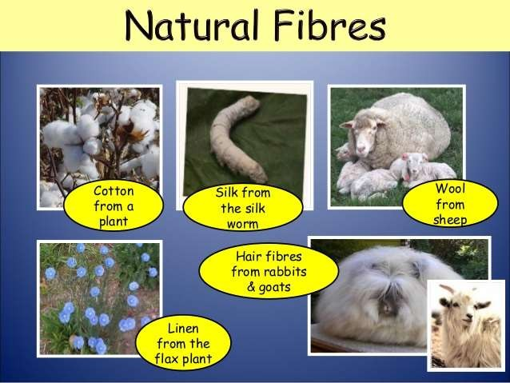

Slide 4
Plant Fibres
◆ Cotton: Cotton fibre is obtained from the cotton plant. It is
one of the traditional fibres used in the textile industry
◆ Linen: Linen fabric is obtained from the flax plant. The properties of linen fabric are very much similar to cotton fabric.
◆ Jute: It is obtained from the jute plant. On account of its high strength, it is perfect for use in packaging material.

Slide 5
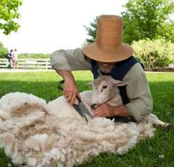
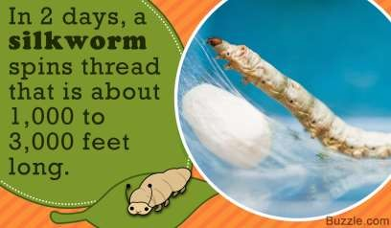
Animal Fibres
◆ Silk: Silk is obtained from silk worms. The most popular kind of silk is obtained from the mulberry silk worm.
◆ Wool: Wool is commonly obtained from sheep. Wool fabric is soft to the touch and provides warmth to the weather, due to which it is the preferred choice for winter apparel.

Slide 6
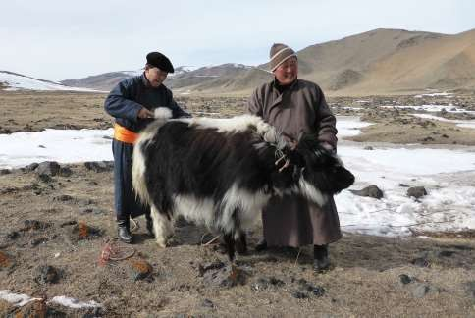
◆ Yak fibre: The yak is an animal that is largely found in the Himalayas in India and Tibet. The hair of the yak is very useful in the production of warm clothes, mats and sacks.

Slide 7
Synthetic Fibres
◆ Synthetic fibres are man-made fibres.
◆ Synthetic fibres are made from different chemicals, hence each kind of synthetic fibres have their own properties.
◆ Synthetic fibres are more in length and are long lasting.
◆ The only limitation in synthetic fibres is that they are poor absorbents of moisture and they catch fire easily

Slide 8
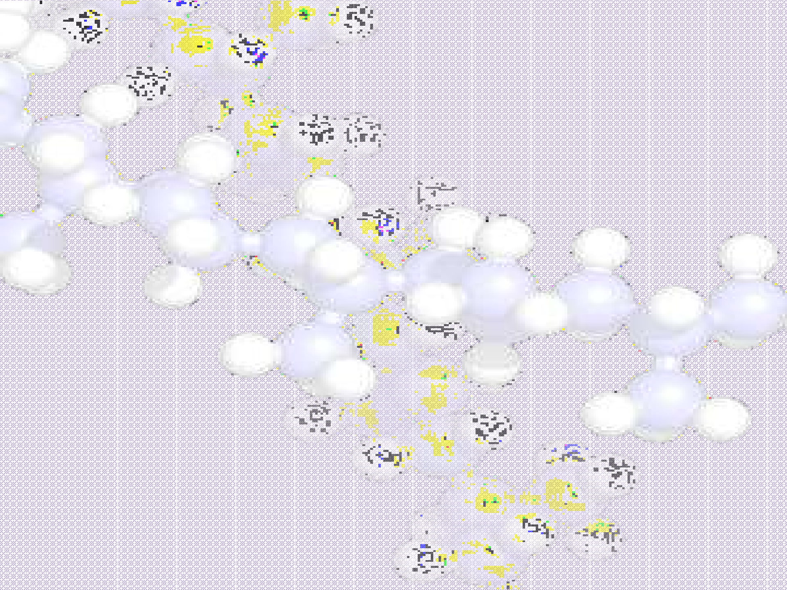

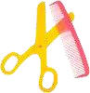
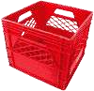
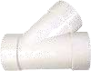
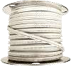
Synthetic Fibres
Many items of clothing contain materials such as polyester, polyamide, terylene, rayon etc.
The items previously mentioned are all man-made fibres, and are called synthetic fibres.

Slide 9
Synthetic Fibres
◆ A synthetic fibre is a chain of small chemical units joined together.
◆ Each small unit is called a monomer.
◆ Large chain formed by many monomers is called a Polymer.
◆ The process of combining small monomers to form a large polymer is called Polymerisation.

Slide 10
Rayon
◆ Rayon is prepared from cellulose.
◆ Though cellulose is a natural polymer it needs extensive chemical treatment to form rayon.
◆ It is also called artificial silk.
◆ It absorbs moisture and is comfortable to wear.
◆ It can be easily dyed in vivid colors.
https://youtu.be/f_AvqnMTJjg

Slide 11

Properties of rayon
easily dyed and wooven into cloth
good absorbent of sweat
Properties
of rayon
drapes well
lustrous in appearance

Slide 12
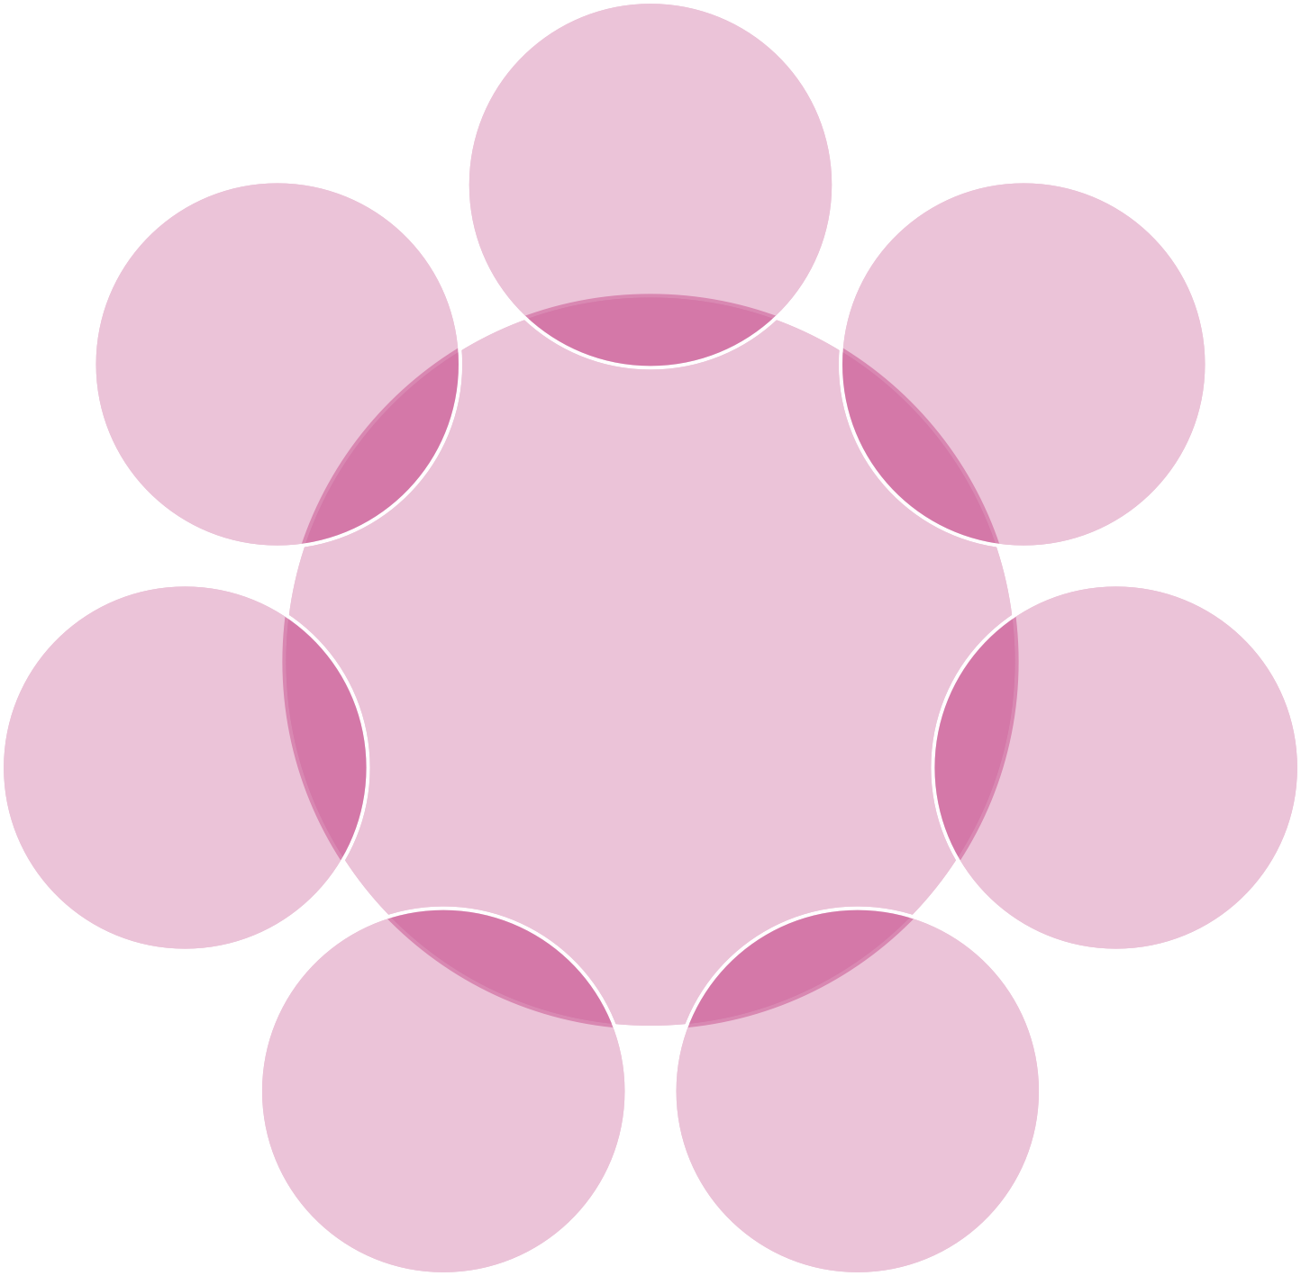
Mixed with fibre glass for making helmets
Dress material because it is soft, silky and moisture absorbent
Used to make Jackets and tracksuits.
Uses of rayon
Curtains because it drapes well
Surgical
Dressings.
Upholstery for luxury cars and officeand home furnishings
Reinforcing nylon tyres

Slide 13
Nylon
◆ Chemically it is a ‘polyamide’, a polymer. It is the strongest synthetic plastic material which can be moulded to any shape.
◆ It is strong and easy to dye.
◆ Nylon fibres do not absorb water easily.
◆ It is elastic in nature and hence, highly durable.

Slide 14
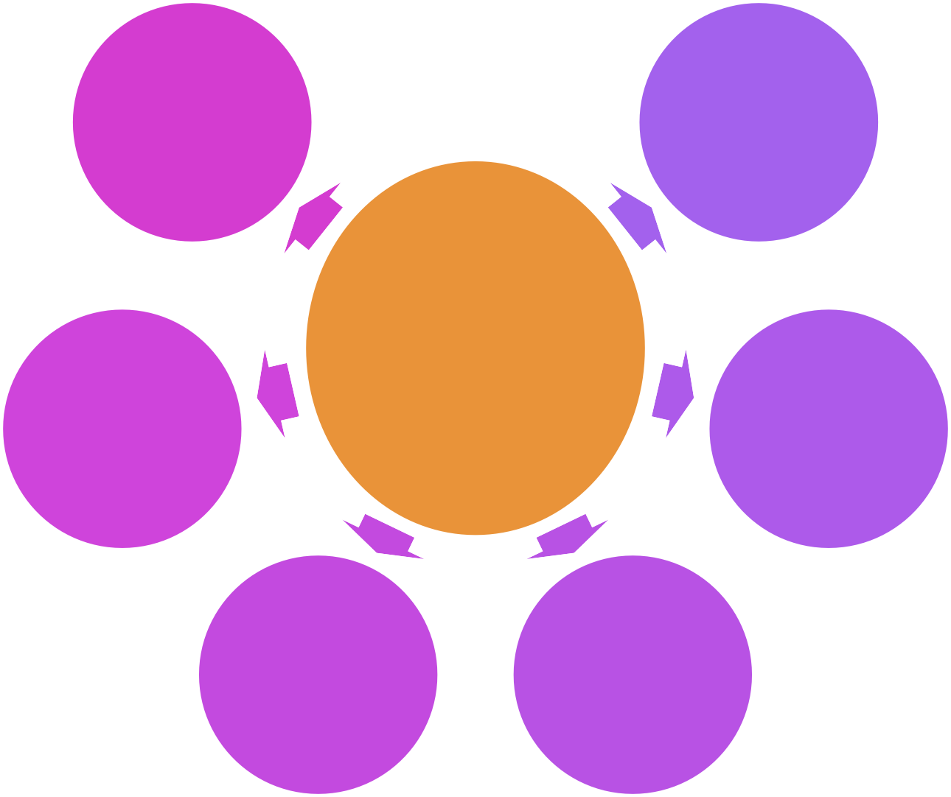
toughest elastic material
is lustrous and easy to wash
high tensile strength
Properties of nylon
can be made into palates or powdered
slightly water absorbent, dries quickly
resists oil, grease, moths, fungus and other pests
It can be moulded into fibres, bristles, sheets, rods, tubes and coatings

Slide 15
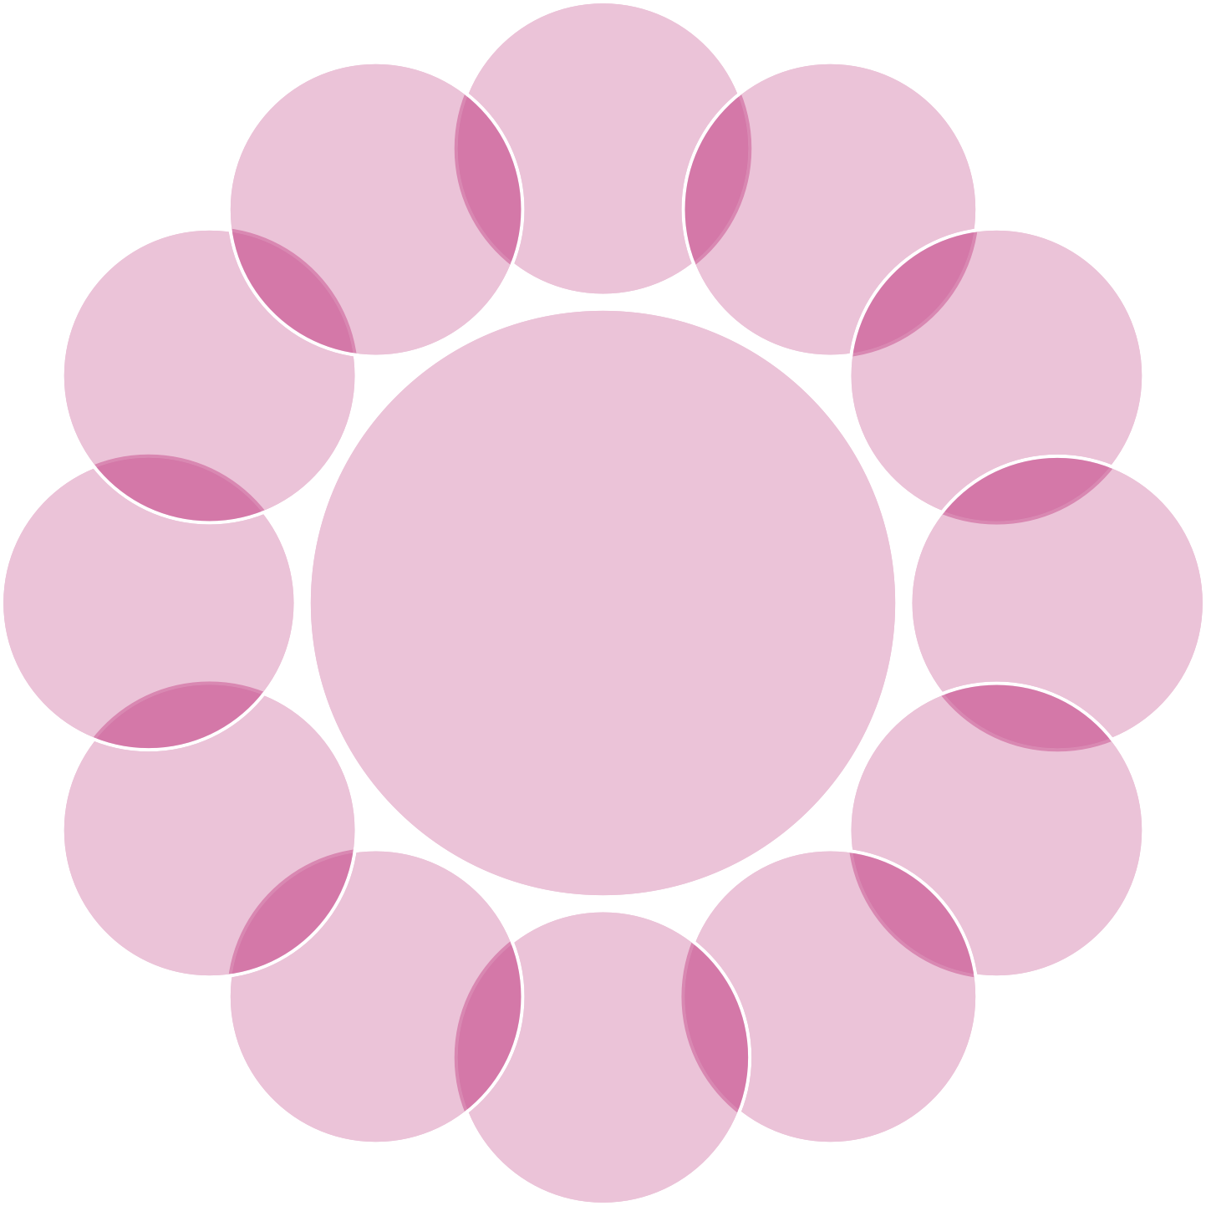
Stretchable wears
Making sarees
seatbelts
fishing nets and fishing lines
Uses of nylon
upholstery
, tracksuits
ropes
raincoats.
reel thread
swimming wears
Sleeping
bags
Thread

Slide 16
Polyester
◆ Alcohol and organic acid react together to make compounds called esters which are polymers
◆ Polyesters come under the brand names of ‘Terylene’, ‘Dacron’, ‘Terene’ and ‘Polyester’.

Slide 17
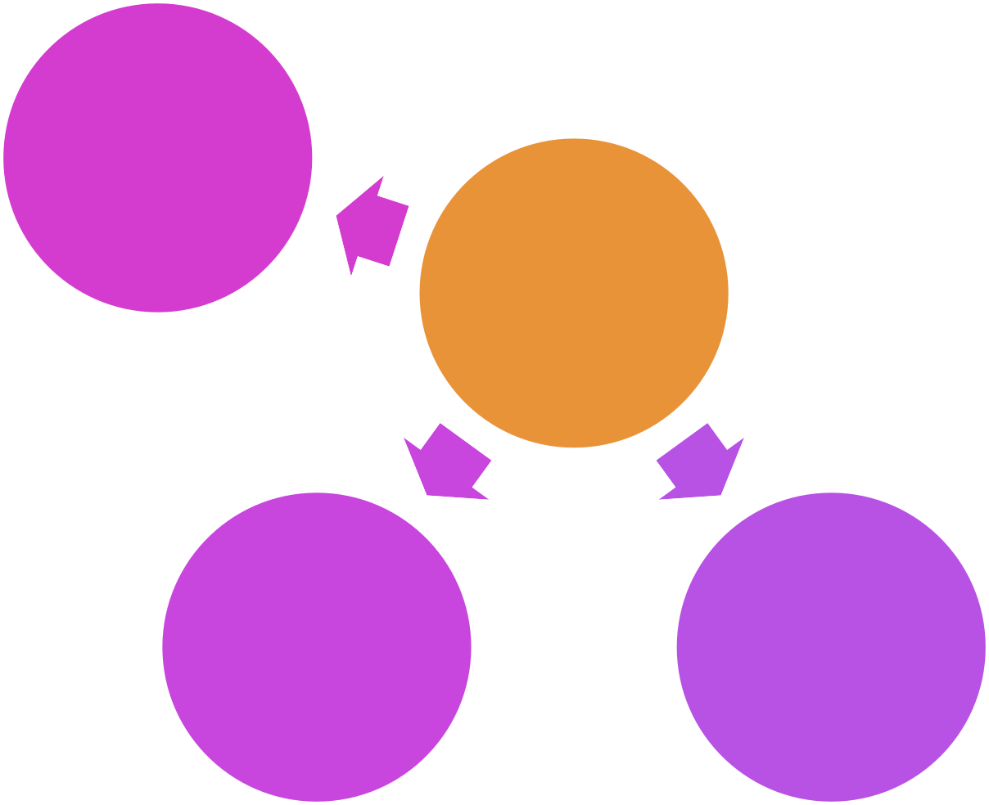
resistant to pests and chemicals
tough, light weight and elastic
dries quickly
Properties of polyester
forms a permanent crease if heated and pressed
easy to wash, does not shrink or stretch

Slide 18
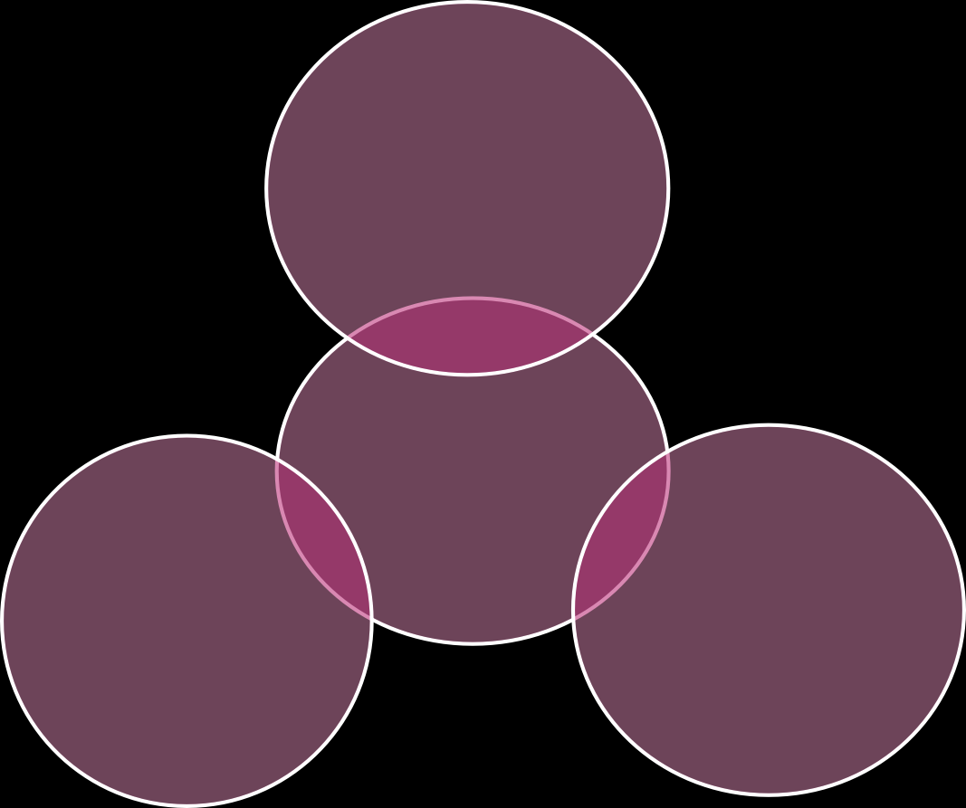
making magnetic audio and video cassettes and floppy disks.
Uses of polyester
mixed with fibre glass for moulding it into helmets, protective sheets and hulls in boats
highly suitable for shirting, suiting, sarees and draperies

Slide 19
Acrylic
◆ Acrylic is often used as a substitute for wool.
◆ Acrylic fibres are strong and wrinkle-resistant.
◆ It is easy to wash and dries quickly.
◆ It is resistant to moths, oils, chemicals and deterioration on exposure to sunlight.

Slide 20
Resistant to moths
Soft with crimps resembling wool
Can be dyed in different colors
Properties of acrylic
Also available in sheets
Is durable light and washable
Strong and stain resistant

Slide 21

Acrylic knitting wool
is good for baby wears because they are soft, warm and washable.
Uses of acrylic
A transparent type of acrylic is used to cover automobile lights, lenses surgical tools etc
Used for making artificial fur, blankets, carpets etc.

Slide 22
Blending Fibres
◆ Terylene and cotton blend, known as terrycot is used for making dress materials.
◆ Terylene and wool blend is known as terrywool is used as a substitute for costly woollen clothes.
◆ Polyester and cotton blend is more crease-resistant.
◆ Acrylic and wool blend trousers are less expensive.

Slide 23
Advantages of Synthetic fibres
◆ Strong
Synthetic fibres are strong so they can take up heavy things easily.
◆ Retain their original shape
Synthetic fibres retain their original shape so it's easy to wash and wear.
◆ Elastic
Can easily be stretched out.
◆ Soft
Synthetic fibres are generally soft so they are used in clothing materials.
◆ Colour
varieties of colours are available as they are manufactured.
◆ Cost
Clothes made by synthetic fibres are generally cheaper than those made by natural fibres.

Slide 24
Disadvantages of Synthetic Fibres
◆ Does not absorb moistures
Synthetic fibres do not absorb sweat, trapping heat in our body.
◆ Rough feel
Synthetic fibres may give rough feel, making it unsuitable for pyjamas, underwear, etc.
◆ It is dangerous to wear near fire, as they catch fire easily.
◆ They cannot be easily ironed as they melt very easily.

Slide 25
NATURAL RUBBER
Natural rubber is a yellowish, Amorphus, Elastic material obtained through coagulated the latex produced by certain plants, particularly the Brazilian Rubber tree (Hevea Brasiliensis).
This raw material is usually tapped from the rubber tree, which is native to Amazonia.

Slide 26
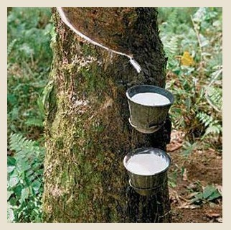
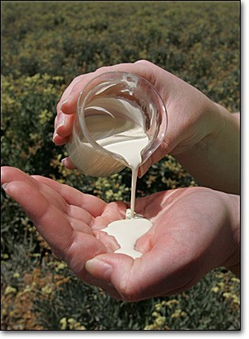
▪ Although there is a large number of species that exude secretions similar to latex when the bark is cut, only a few produce sufficient quantities of quality adequate for exploitation on economic bases.

Slide 27
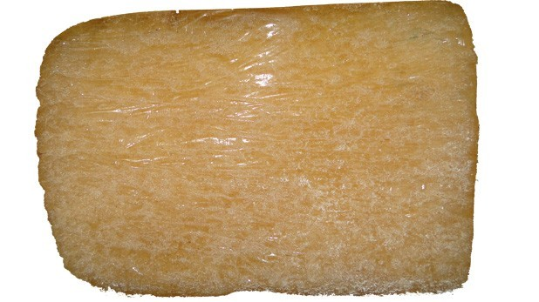
SYNTHETIC RUBBER
▪ A material with the chemical property that it can undergo elastic deformation under stress and still return to its previous size without permanent deformation.

Slide 28
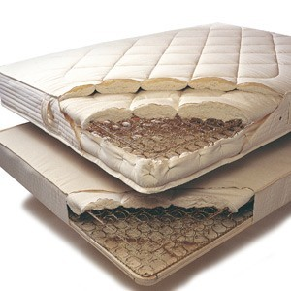
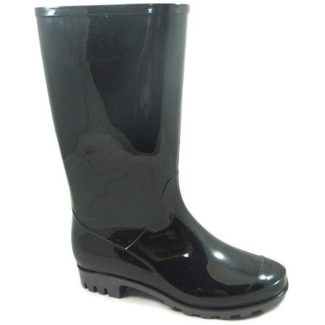

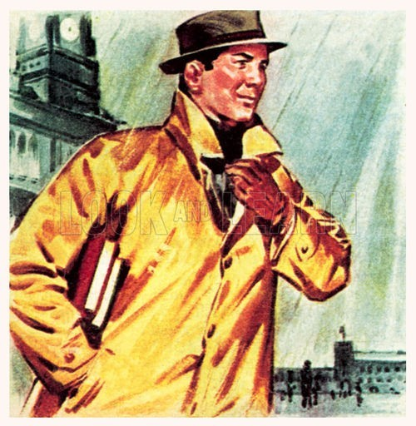
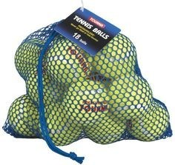
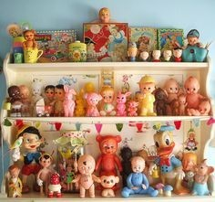
Uses of rubber
Notes:
U

Slide 29
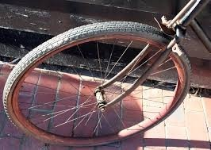
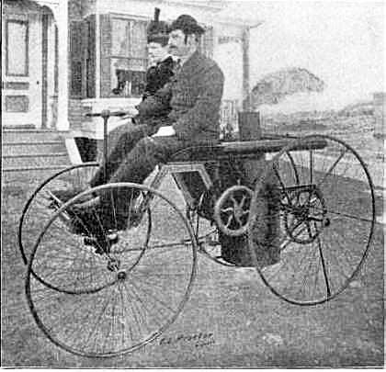
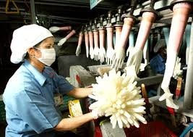
Uses of Rubber

Slide 30
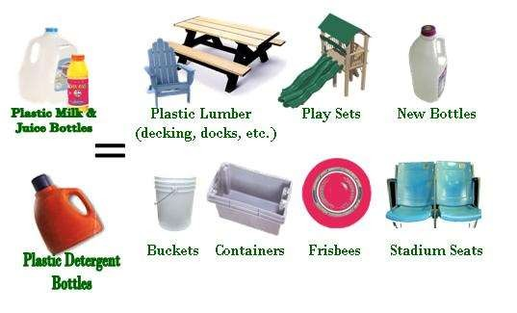
Plastics

Slide 31
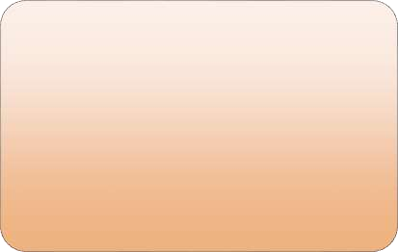
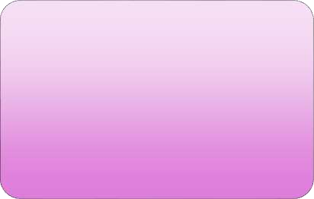
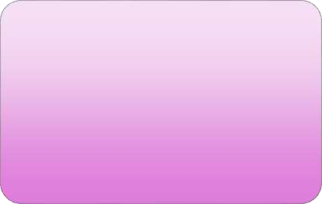
Types of plastics
Thermosetting Plastics
thermoplastics

Slide 32
Thermosetting plastics
◆ Thermoset plastics are hard and rigid. Example is Bakelite and melamine.
◆ Thermoset can be moulded to set it in any shape but it cannot be remoulded.
◆ It is dark in color, hard and resistant to heat and electricity.
◆ It is being widely used for the handle of kettles and pans.
◆ Earlier black telephone sets, electric switches, electric lamp holders, pins and plugs were made from thermoset plastic.

Slide 33



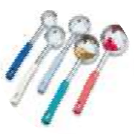
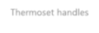
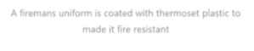
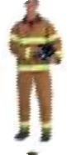

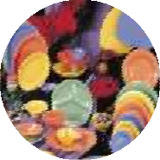


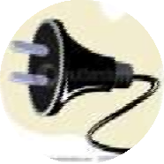

Examples of theroset plastics
Thermoset handles
A firemans uniform is coated with thermoset plastic to made it fire resistant
Melamine wares
An electric pin (black)

Slide 34
Thermoplastics
◆ Thermoplastics are soft and flexible.
◆ They are not elastic like rubber and steel springs.
◆ They melt on warming and regain their shape on cooling.
◆ Thermoplastics can be drawn into fine fibers, moulded to any desired shape or stretched or spread as sheets.
◆ Some of the better known thermoplastics are nylon (polyamide), polyesters, polyethylene, polyvinyl chloride (PtfC), acrylic, polyurethane, polypropylene (PP), poly- tetra-fluoro-ethylene (PTEE) etc

Slide 35
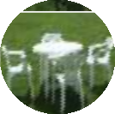

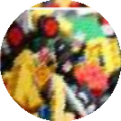
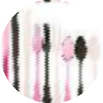
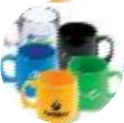
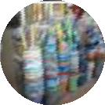
Thermoplastics examples
Plastic table and chairs
Plastic food containers Plastic toys
Plastic spoons and forks Plastic cups
Plastic daily use items

Slide 36
Properties of Plastics
◆ Resist corrosion
◆ Resist high temperatures
◆ Insulate heat and electricity
◆ Elastic
◆ Thermoplastics can be recycled
◆ Not reactive to Chemicals and water
◆ Water resistant
◆ soft when hot

Slide 37
Plastics and the environment
◆ Recycling waste plastic is very important. It may kill many animals as well as polluting Earth.
◆ Plastics are not biodegradable.
◆ Few years ago, scientists have discovered photodegradable plastics that can be broken down by sunlight, but it takes very long time to rot.
◆ Recently, scientists developed biopolymers, biodegradable polymers. They rot very easily, for example plastics made from corn starch, dissolves rapidly in water.

Slide 38


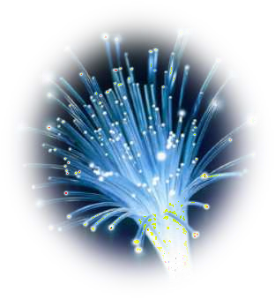
What is an Optical Fibre
An optical fiber is a flexible, transparent fiber made of high quality extruded glass

Slide 39


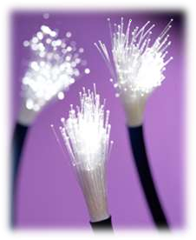
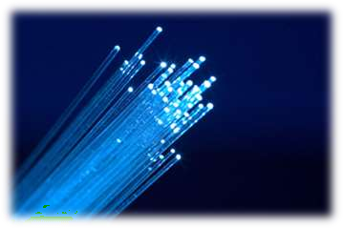

It consists of thousands of strands of
fine quality glass or quartz
refractive index about 1.7
thickness about 10⁻⁶

Slide 40

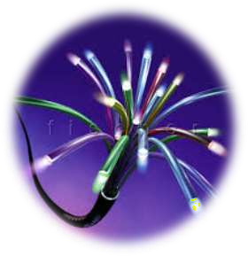
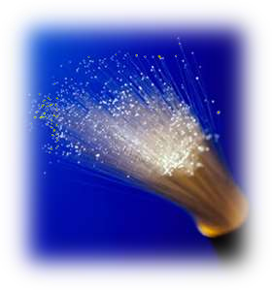
Each fibre acts as a pipe and such a bundle of fibers can be used to convey images along paths of any shape it is pointed.

Slide 41
What is Glass?
SUPERCOOLED LIQUID
LIQUID WHICH IS COOLED TO A STAGE WHERE ITS VISCOSITY IS SO GREAT THAT THE MOLECULES DO NOT MOVE FREELY ENOUGH TO FORM CRYSTALS

Slide 42
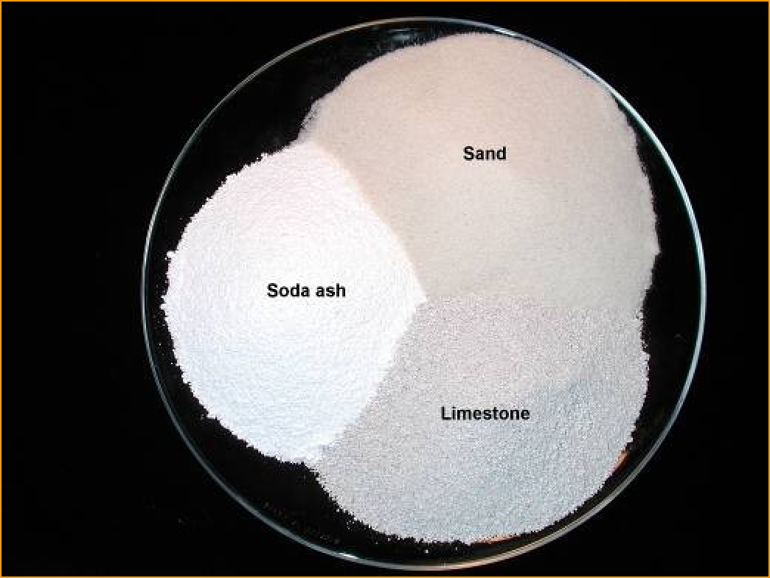
What is glass made of?
Sand – 70% Soda Ash – 15% Limestone – 10%

Slide 43
Manufacturing Process
FOLLOWING ARE THE STEPS FOR THE MANUFACTURING OF GLASS
MELTING
SHAPING AND FORMING
ANNEALING
FINISHING
https://youtu.be/-z1P2cK9Rro

